Slide 1

TKR College of Engineering and Technology Department of ECE
Design of Turbo Encoder Module
for In-Vehicle System
Under the guidance of : Submitted by:
Ms. G. ANITHA CHOWDARY M.SAI JAGADEESH (20K91A04C0)
(Associate. Professor) N.NIVAS (20K91A04C5)
M.SIDDARTHA (20K91A04B4)

Slide 2

CONTENTS
Objective
Introduction
In-Vehicle System(IVS)
Turbo encoder module
Design for the Turbo encoder module
Software Tools Used
Advantages
Applications
Conclusion
Future scope

Slide 3
OBJECTIVE
The main objective of the project is reduce the number of the cycles.
In this project we are designing the Turbo encoder using carry increment adder(CIA) and these are implemented in Verilog HDL.
Simulation and circuit synthesis has been done using XILINX ISE 14.7.

Slide 4
INTRODUCTION
The European emergency call (eCall) system is designed to save more lives in vehicle accidents.
It is a governmental mandatory system that is to be implemented by March 2018 .
The EU eCall system provides an immediate voice and data channel between the vehicles and an emergency center after car accidents.
The EU eCall system main parts includes the in-vehicle system (IVS).

Slide 5
IN-VEHICLE SYSTEM
The IVS activates the data channel automatically when a car accident occurs.
The IVS collects the minimum set of data (MSD) that includes GPS coordinates, the VIN number, and all required data for an emergency accident.
The IVS modem employ multiple modules for the MSD signal. The IVS employs a Turbo encoder as a forward error correcting (FEC).
The Turbo encoder implements the digital data encoding technique in data transmissions.

Slide 6
The IVS block diagram
CAN
ECU
Turbo Encoder
GSM Module
CRC
Modulator
BCH Decoder
Demodulator

Slide 7
Turbo Encoder Module
The IVS employs a Turbo encoder module with 1/3 code rate.
The input signal of the turbo encodes is the MSD data.
The block length of the MSD data is 1148 bits.
The output of the module is the MSD encode data in binary.
Implementing the turbo coding technique with 1/3 coding rate, the length of the output is 3456 bits.
The Turbo encoder employs a parallel concatenated convolutional code (PCCC).
The length of the input data, parity1, and parity2 are 1148 bits.
There are 12 bits of the tail bits, They are driven from the shift register feedback.
The tail bits are applied for end points between the encoded data blocks.

Slide 8
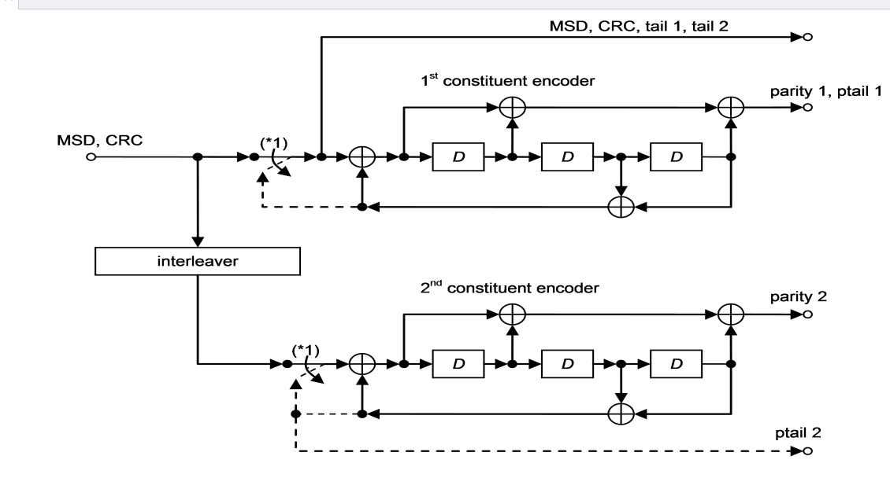
The Structure of the Turbo encoder

Slide 9
Interleaver
Denote the transfer function of the employed PCCC as:
G(D) = (1,g1(D)/g0(D))
where
g1(D) = 1 D2 D3
g0(D) = 1 D D3

Slide 10
The output buffer of the Turbo encoder
MSD+CRC tail1 tail 2 Parity 1 Ptail 1 Parity 2 Ptail 2

Slide 11
DESIGN OF THE TURBO ENCODER MODULE
The register transfer level(RTL) of the Turbo encoder module is develop in Verilog HDL.
This work study two methods, which are serial computation and parallel computation.
The serial computation method processes one bit in one clock cycle. The parallel computing technique is employ to develop the Turbo encode in Verilog.
The Turbo encoding technique need the MSD data to implement the encoding.

Slide 12
Carry Increment Adder
In this project we are adding the carry increment adder to reduce the number of cycles, parameters and power consumption of the turbo encoder.
It is a combination of two ripple adders, and gates exor gates.
Ripple adders is a combination of four full adders with the one full adder carry out put is connected to the input of the other full adder.

Slide 13
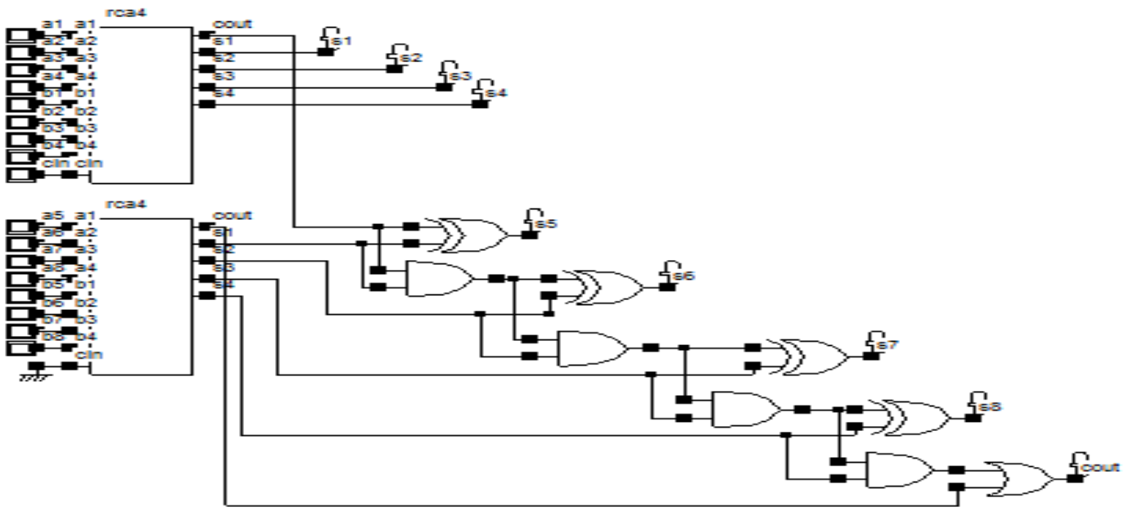
CARRY INCREMENT ADDER FOR PROPOSED DESIGN

Slide 14

Software Tools Used Language Used: Verilog
Tool Used: Xilinx

Slide 15
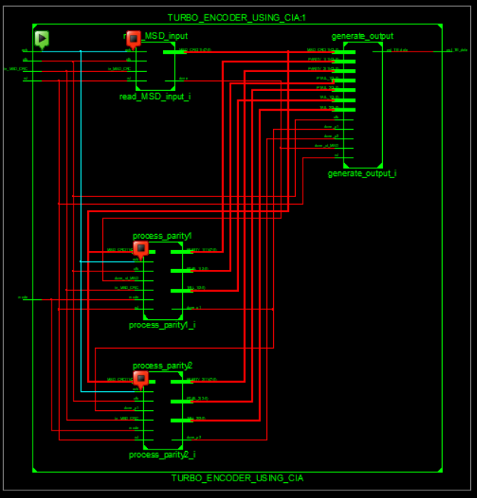
Schematic Diagram

Slide 16
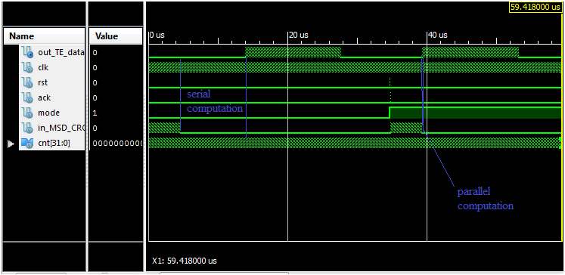
SIMULATED WAVE FORMS

Slide 17
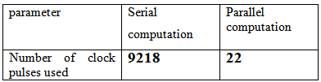
Clock Pulses Comparison table

Slide 18
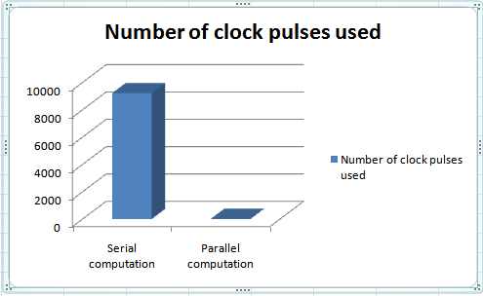
clock pulses comparison bar graph

Slide 19
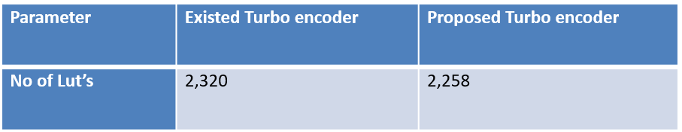
No.of Lut’s Comparison Table

Slide 20
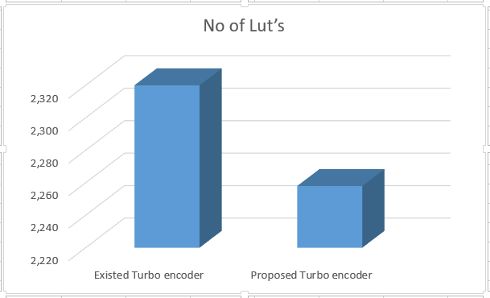
LUT comparison bar graph

Slide 21
Advantages
Reducing the parameters of the turbo encoder.
It is secure.
Reducing the power consumption.
Reducing the clock pulses.

Slide 22
Applications
It is used in IVS(in vehicle system) to send the MSD(minimum set of data) like GPS and VIN(vehicle identification number) to the receiver.
To send the information safely by increasing the bites length.
To save the more lives in accidents by send the vehicle information to the near emergency center after car accident.
To know the information about the vehicle accidents.

Slide 23
CONCLUSION
The Turbo encoder module using carry increment adder is designed and implemented to be an embedded module in the IVS modem.
Xilinx tools and Verilog HDL are employed to design and simulate the module. Both serial and parallel computation techniques are studied for the encoding process.
It is shown that the parallel computation can improve the chip size and processing time of the module.
Comparing with the serial computation technique, the parallel computation encoding, using only 22 clock pulses and it improves the processing time by and logic utilization by 9218 clock pulses.
Additionally the proposed structure reduced area and power also. The processing time enhancement can be seen in both simulation and analyzing the chip processing.

Slide 24
FUTURESCOPE
Turbo encoders are error-correcting codes with performance close to the Shannon theoretical limit [SHA]. The encoder is formed by the parallel concatenation of two convolution codes separated by an interleaver or permuter.
In this project, I modeled and implemented a turbo encoder using magnitude comparator scheme using serial and parallel computing algorithm.
The advantage of turbo codes over existing coding schemes is that it attains a very low BER at low signal-to-noise ratios,so it will be used in used in communications . This makes it suitable for wireless applications where low transmission power is desired. However, the performance of turbo encodes on Rayleigh and Ricean fading channels remain an active subject of research.
The portability of this code to Advanced Design System (ADS) would be very beneficial for code re-usability and also the synthesis capability of ADS would result in faster product development.

Slide 25
REFERENCE
[1]eCall data transfer; in-band modem solution; general description,” 3GPP, Tech. Rep. TS26.267.
[2]C. Studer, C. Benkeser, S. Belfanti, and Q. Huang “Design and Implementation of a Parallel Turbo-Decoder ASIC for 3GPP-LTE,” IEEE Journal of Solid-state Circuits., vol. 46, no. 1, pp. 8-17, Jan. 2011.
[3] M. Nader and J. Liu, “Design and implementation of CRC module ofeCall in-vehicle system on FPGA,” SAE Technical 2015-01-2844, 2015, doi:10.4271/2015-01-2844.
[4] “Technical Specification Group Radio Access Network; Multiplexing andchannel coding (FDD),” 3GPP, Tech. Rep. TS22.212.
[5]D. Viktor, K. Michal, and D. Milan“Impact of trellis termination onperformance of turbo codes,” in ELEKTRO, 2016, pp.48-51.

Slide 26

THANK YOU

